Slide 1

water scarcity in the Arab world
Name: Rony Al Moussa
Id: 220339
Course: Tm471
Major: Data science
Supervisor: Dr. maya Dawood
Date: 5/2024

Slide 2
Table of contents 1
I. Introduction:
. Problems and Solutions
.Aim and Scope
.Approaches and methods used
II. Literature Review:
.mWater
.AkvoFlow
.Open Water Data
.Comparative Table
.Solution
III. Diagrams:
.Introduction . ETL pipeline architecture
. Merging datasets

Slide 3
Table of contents 2
IV. Implementation:
.Code of cleaning and merging the datasets
. Uploading the merged datasets to drive
.Code of our outputs
V. My outputs
VI. References

Slide 4
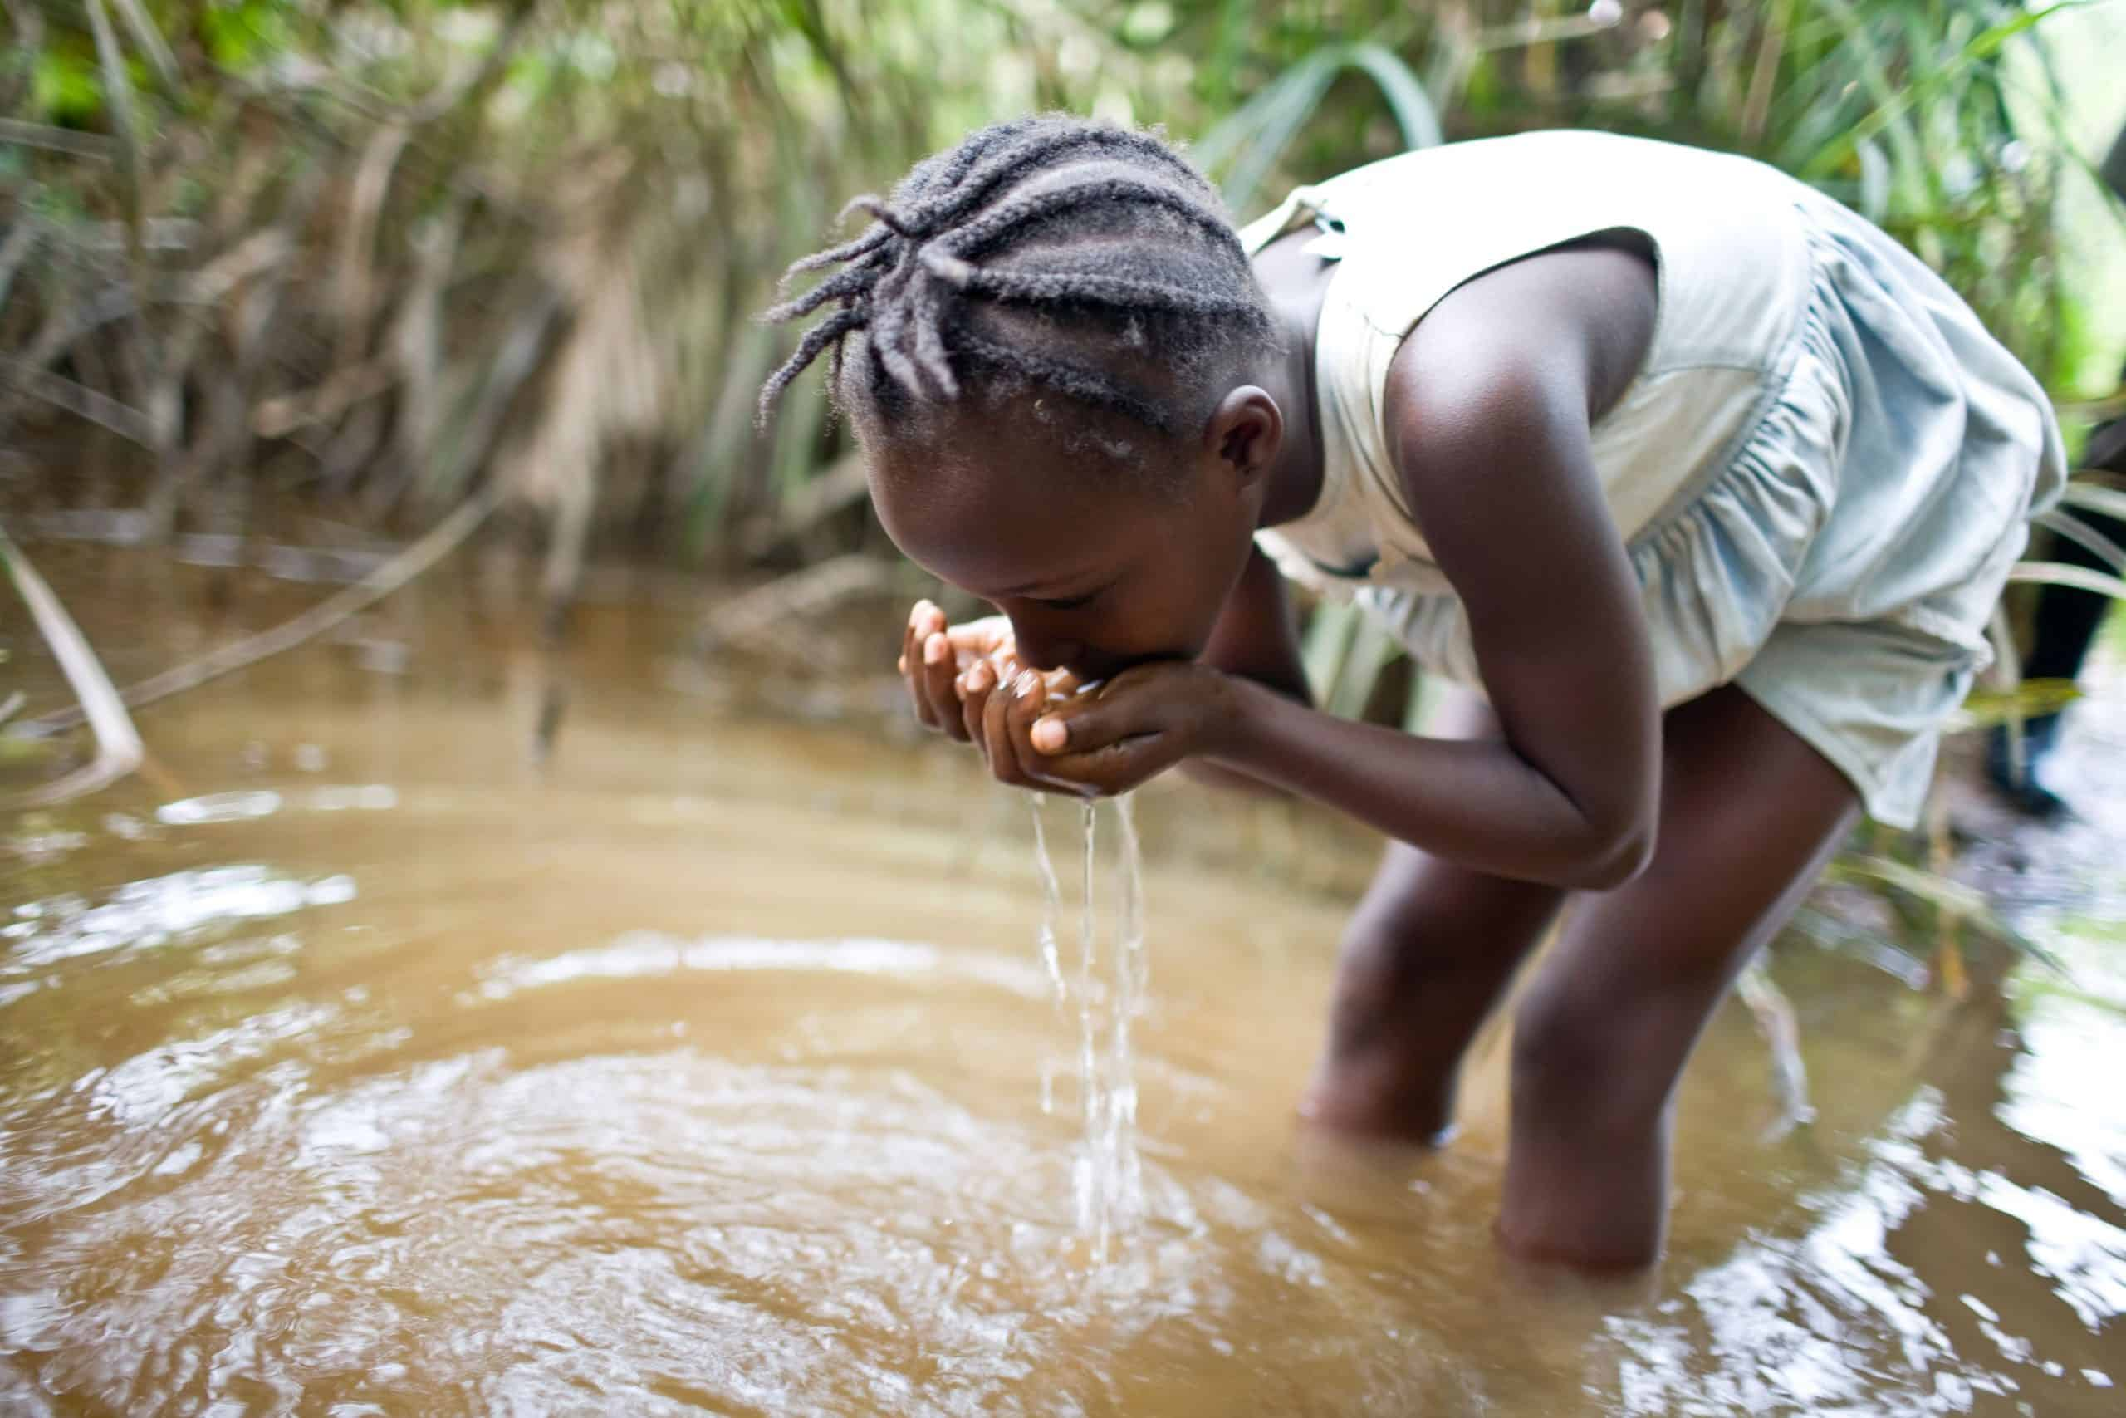
I. Introduction
. Problems:
. 2 billion people don’t have clean water to drink.
. Possible clean water shortage in the Arab world.
. Affecting many industries.
. Solutions:
. Analyze already existed data.
. Present accurate data.
. Create a new algorithm to solve this problem.
. Updating the data continuously.

Slide 5
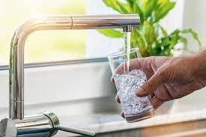
I. Introduction
. Aim and scope:
. Predict the date when there will be no more clean water in the Arab world.
. Help the main stakeholders to solve this crisis.
. The database must be updated continuously.

Slide 6
I. Introduction
. Approaches and methods used:
. Identifying the risks before starting.
. Split our project into small tasks.
. Use python and its libraries in the implementation part.

Slide 7
II. Literature review
. mWater:
Establishment year: 2010.
Establishment country: USA.
Abstract: mWater is a free platform to collect, clean, and analyze data about clean water.
Advantages: Easy data collection, available offline, Customizability.
Disadvantages: Not easy to use, Scalability, Cost.

Slide 8
II. Literature review
. Akvo Flow:
Establishment year: 2008.
Establishment country: Sweden.
Abstract: bring innovative technology to the development sector.
Advantages: Easy data collection, available offline, Visualizations.
Disadvantages: Not easy to use, limited integration.

Slide 9
II. Literature review
. Open Water Data:
Establishment year: 2017.
Establishment country: India.
Abstract: Enabling the users to add data sources to scale out.
Advantages: Comprehensive data, Visualizations, Decision Support.
Disadvantages: Only available in India, Technical expertise.

Slide 10
II. Literature review –Comparative table
Existing Solutions | Advantages | Disadvantages | Features
mWater | Easy Data Collection Available offline Visualizations Customizability | Not easy to use Limited Scope Technical requirements Scalability Integration Cost | Data collection Visualizations Real-time monitoring Customizability Mobile and Web compatibility
AkvoFlow | Easy Data collection Available offline Customizable forms Real-time monitoring Visualizations | Limited integration Not easy to use Not available in all countries | Mobile support Customizable forms Offline data collection Real-time monitoring Visualizations
Open Water Data | Comprehensive data Visualizations Decision support Integration opportunities | Data availability Technical expertise | Diverse datasets Visualizations Decision support Open-Data approach

Slide 11
II. Literature review –Solution
We will try to have a system that is/has:
. Easy-to-use
. Free of charge
. Scalable
. Enough integrations
. Diverse Dataset
. Offline data collection
. Visualizations
. Real-time monitoring

Slide 12
III. Diagrams
Introduction:
.Firstly, we need to search for reliable datasets .
UNICEF, GlobalWaters, OurWorldInData, and DataWorld
.Filter our results only in the Arab countries.
.Took 6 sub datasets and 1 main dataset.

Slide 13
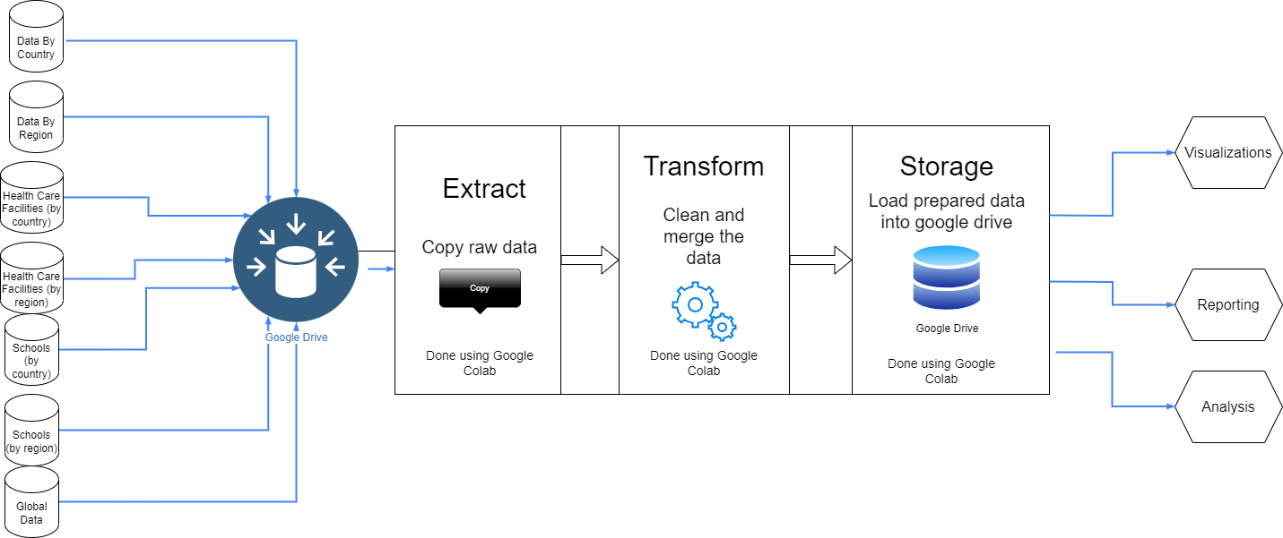
III. ETL pipeline architecture

Slide 14
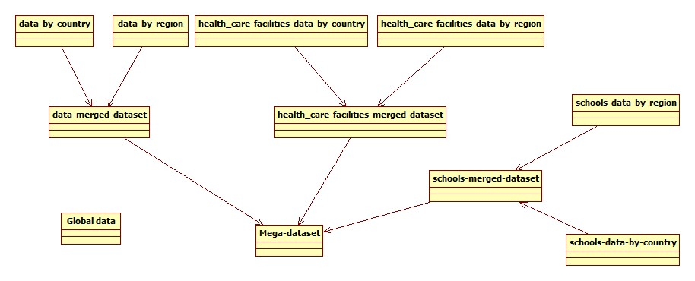
III. Merging datasets

Slide 15
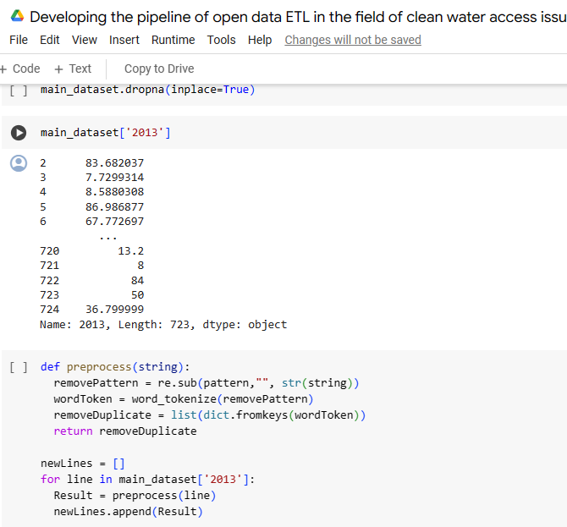
IV. Implementation:
Code of cleaning the datasets:
dropping the null values
removing the duplicates using
a function
. The link of the code:
Developing the pipeline of open data ETL in the field of clean water access issue in the Arab countries.ipynb - Colab (google.com)

Slide 16
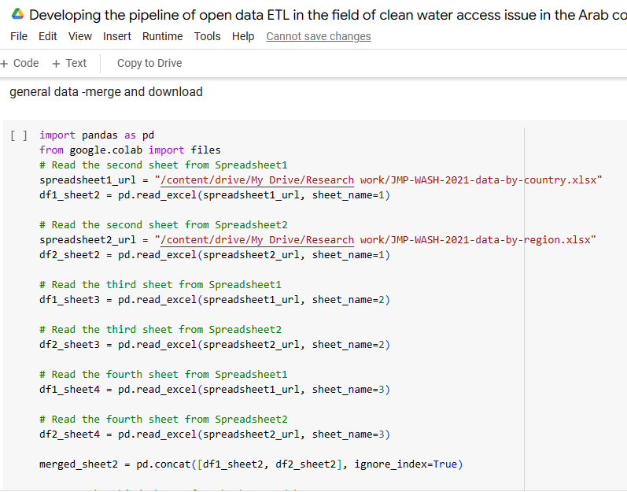
IV. Implementation:
Code of merging the datasets:
In the same notebook, we merged the
cleaned datasets by their sheets
. We merged the alternative spreadsheets
together.

Slide 17
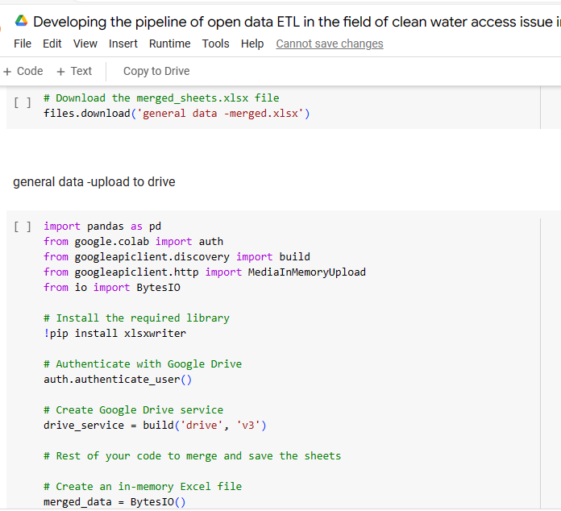
IV. Implementation:
Uploading the merged datasets to drive
. The merged dataset between the first and the
second dataset is called: “general data –merged’
. We upload it to drive with the help of the libraries
in the picture and using a python code.
. We do the same for the rest of our datasets
. Finally, we merged all our datasets in one general
and clean dataset.

Slide 18
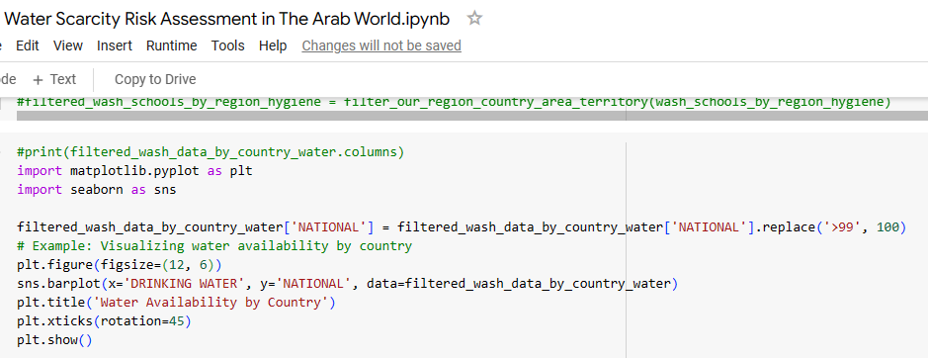
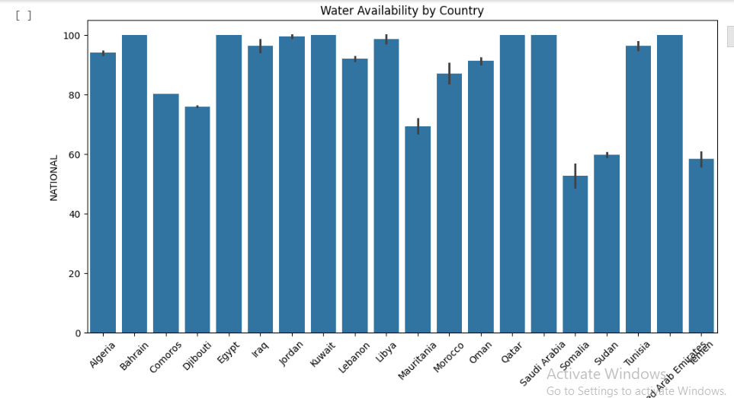
IV. Implementation:
Code of our outputs:
. We used the general
dataset.
. We used the libraries
in the picture.
. The link of the code:
Water Scarcity Risk Assessment in The Arab World.ipynb - Colab (google.com)
We got a graph like:

Slide 19
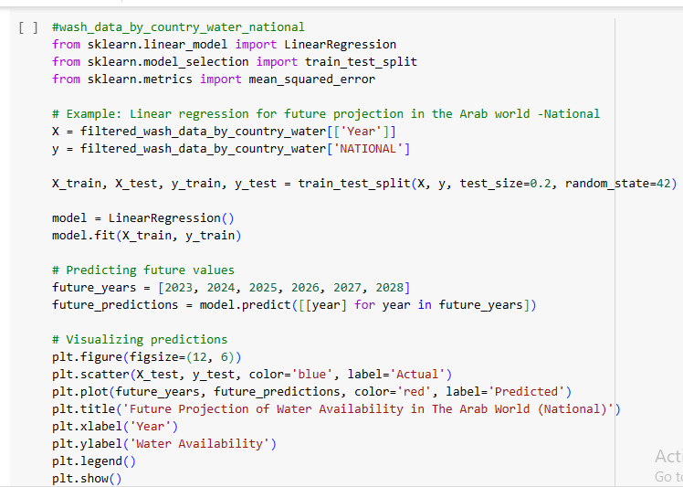
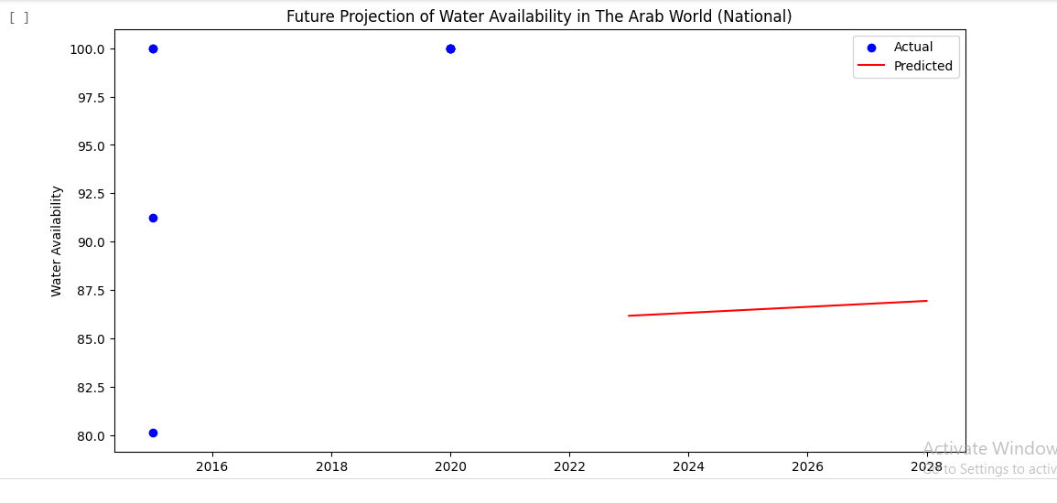
IV. Implementation:
Code of our outputs:
. In the same notebook:
. We used the general
dataset.
. We used the libraries
in the picture.
.We got a graph like:
(Projection)

Slide 20
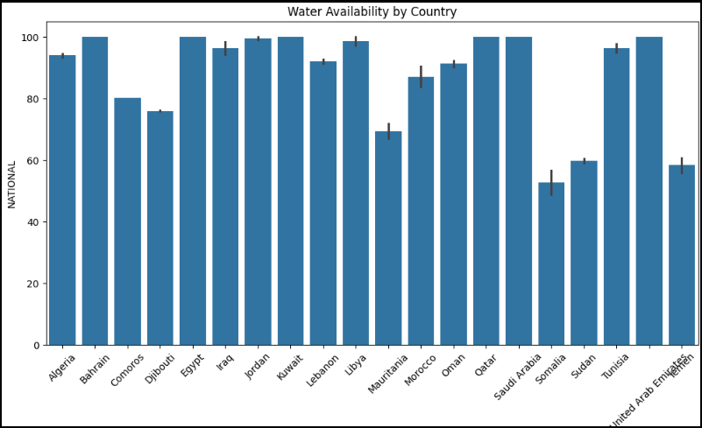
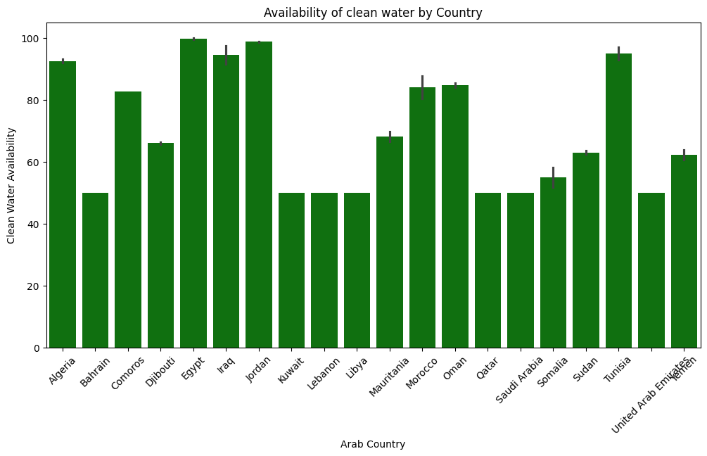
V. My outputs:

Slide 21
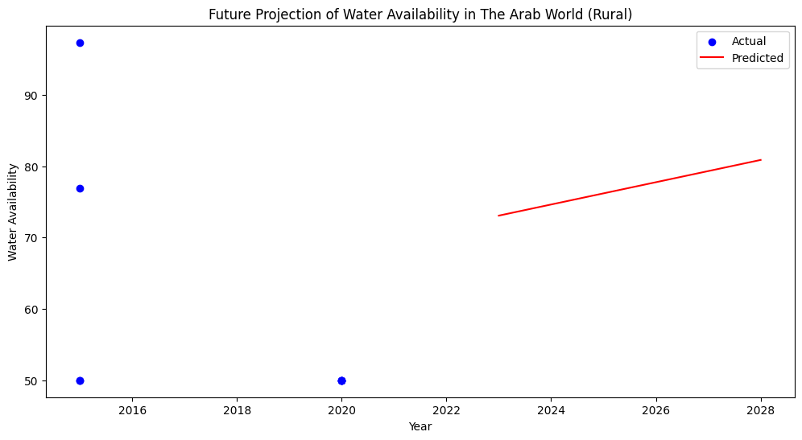
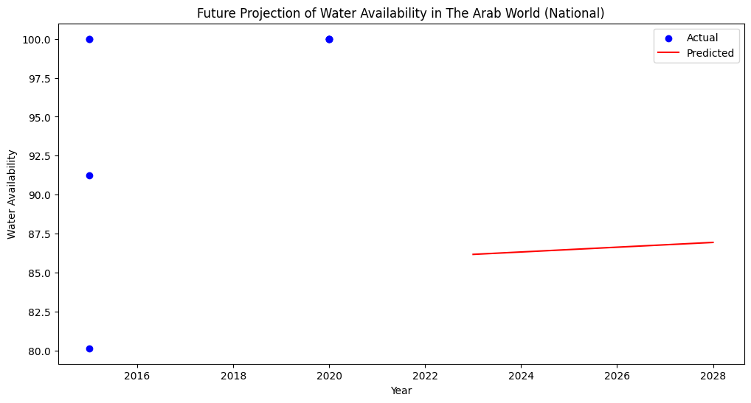
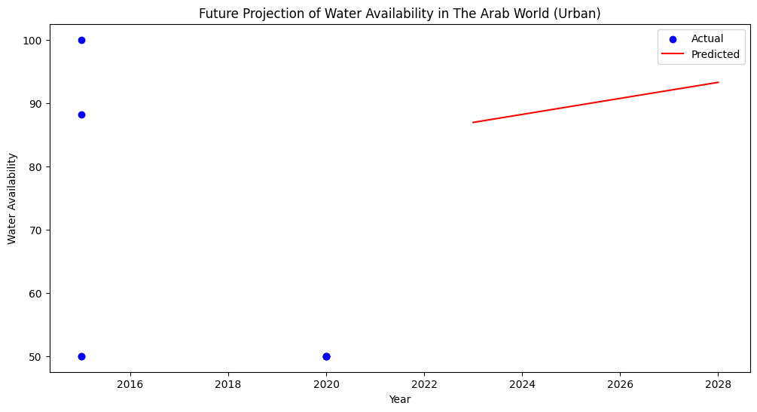
V. My outputs:
Rural
National=
+ Urban

Slide 22
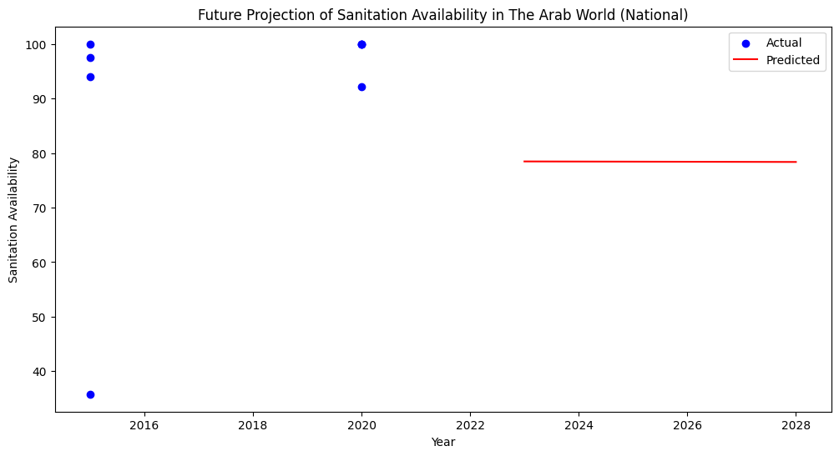
V. My outputs:

Slide 23
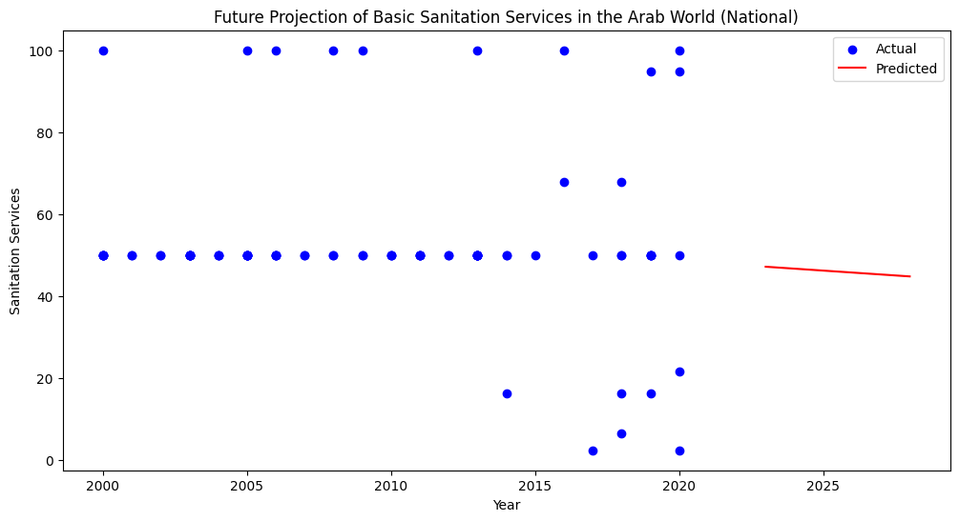
V. My outputs:

Slide 24
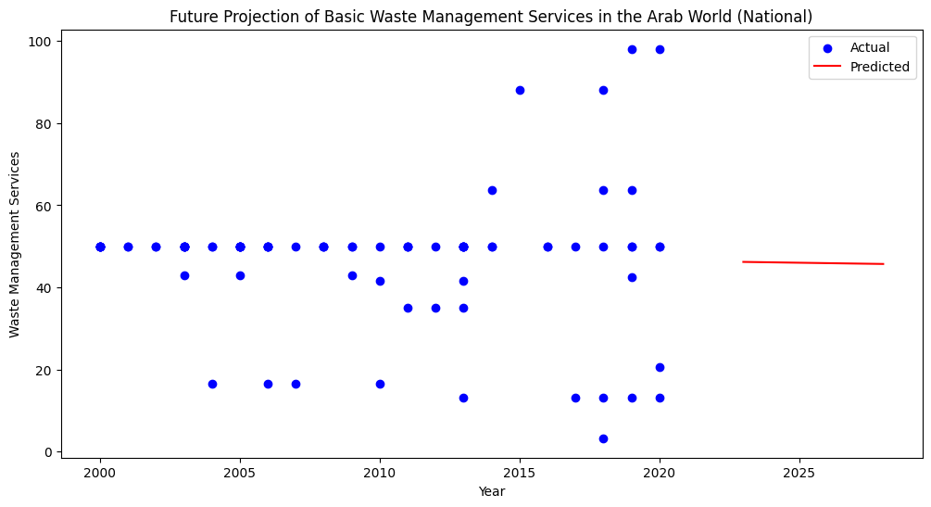
V. My outputs:

Slide 25
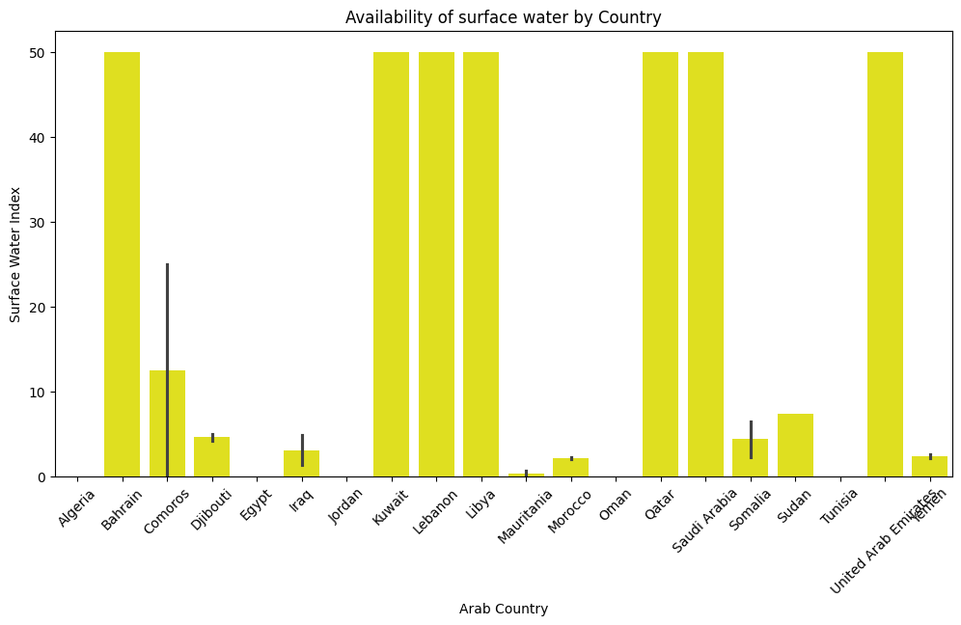
V. My outputs:

Slide 26
V. My outputs:
All my outputs are available online
All the main stakeholders can benefit from them by analyzing them and making decisions that could benefit their countries to limit the water scarcity risk in the future knowing that they has reliable sources.

Slide 27
V. References 1
World Wildlife Fund (2022). Water Scarcity | Threats | WWF. [online] World Wildlife Fund. Available at: https://www.worldwildlife.org/threats/water-scarcity [Accessed 10 Jun. 2023].
UNICEF (2020). Water scarcity. [online] www.unicef.org. Available at: https://www.unicef.org/wash/water-scarcity#:~:text=Half%20of%20the%20world [Accessed 10 Jun. 2023].
Chien, C. (2020). How do you identify and manage risks in software development? [online] Codebots. Available at: https://codebots.com/way-of-working/how-do-you-identify-and-manage-risks-in-software-development [Accessed 10 Jun. 2023].
Wrike. (2023). What is Iterative and Incremental Development? [online] Available at: https://www.wrike.com/project-management-guide/faq/what-is-iterative-incremental-development/ [Accessed 10 Jun. 2023].
Zoe. (2022). Project Schedule Management [10 Reasons why it’s important]. [online] Available at: https://zoetalentsolutions.com/project-schedule-management/ [Accessed 10 Jun. 2023].
Pubrica Academy (2019). Why is it important to do a literature review in research? [online] Pubrica. Available at: https://pubrica.com/academy/research/why-is-it-important-to-do-a-literature-review-in-research/ [Accessed 10 Jun. 2023].
mWater. (2021). mWater. [online] Available at: https://www.mwater.co/ [Accessed 10 Jun. 2023].
Akvo Foundation. (2023). Better data, bigger impact. [online] Available at: https://akvo.org/ [Accessed 16 Jun. 2023].
Emeline, E. (2022). Data is the new water. [online] datajourney.akvo.org. Available at: https://datajourney.akvo.org/blog/data-is-the-new-water [Accessed 16 Jun. 2023].
www.openwaterdata.com. (2023). Open Water Data. [online] Available at: https://www.openwaterdata.com/ [Accessed 10 Jun. 2023].
Apostolopoulos, I.D. and Groumpos, P.P. (2023). Fuzzy Cognitive Maps: Their Role in Explainable Artificial Intelligence. Applied Sciences, 13(6), p.3412. doi:https://doi.org/10.3390/app13063412.
Kok, K. (2023). Fuzzy Cognitive Maps (pros and cons). [online] Research Gate. Available at: https://www.researchgate.net/figure/Strong-and-weak-points-of-Fuzzy-Cognitive-Mapping_tbl2_222390094 [Accessed 10 Jun. 2023].
Concepcion, L., Nápoles, G., Bello, R. and Vanhoof, K. (2020). On the Behavior of Fuzzy Grey Cognitive Maps. pp.462–476. doi:https://doi.org/10.1007/978-3-030-52705-1_34.
Wang, J. and Guo, Q. (2018). Ensemble Interval-Valued Fuzzy Cognitive Maps. IEEE Access, 6, pp.38356–38366. doi:https://doi.org/10.1109/access.2018.2853995.
Aguilar, J. (2010). Dynamic Fuzzy Cognitive Maps for the Supervision of Multiagent Systems. pp.307–324. doi:https://doi.org/10.1007/978-3-642-03220-2_13.

Slide 28
V. References 2
World Wildlife Fund (2022). Water Scarcity | Threats | WWF. [online] World Wildlife Fund. Available at: https://www.worldwildlife.org/threats/water-scarcity [Accessed 10 Jun. 2023].
UNICEF (2020). Water scarcity. [online] www.unicef.org. Available at: https://www.unicef.org/wash/water-scarcity#:~:text=Half%20of%20the%20world [Accessed 10 Jun. 2023].
Coursera (2023). What Is a Data Pipeline? (+ How to Build One). [online] Coursera. Available at: https://www.coursera.org/articles/data-pipeline [Accessed 26 Jul. 2023].
Hughes, A. (2023). The Key Steps in the ETL Data Integration Process. [online] Cleo. Available at: https://www.cleo.com/blog/knowledge-base-etl-integration#:~:text=The%205%20steps%20of%20the [Accessed 26 Jul. 2023].
Pedamkar, P. (2019). What is ETL? | How it Work | Needs and Advantages | Scope & Career. [online] EDUCBA. Available at: https://www.educba.com/what-is-etl/ [Accessed 26 Jul. 2023].
World Wildlife Fund (2022). Water Scarcity | Threats | WWF. [online] World Wildlife Fund. Available at: https://www.worldwildlife.org/threats/water-scarcity [Accessed 25 Jan. 2024].
Maxwell, D. (2015). The Risks and Opportunities Posed by Water Can’t Be Ignored—by Business, Industries, or Nations | IFAC. [online] www.ifac.org. Available at: https://www.ifac.org/knowledge-gateway/contributing-global-economy/discussion/risks-and-opportunities-posed-water-cant-be-ignored-business-industries-or-nations#:~:text=Water%20risk%20factors%20include%20water [Accessed 25 Jan. 2024].
Impulse, S. (2022). Solutions to water scarcity: how to prevent water shortages? [online] solarimpulse.com. Available at: https://solarimpulse.com/water-scarcity-solutions# [Accessed 25 Jan. 2024].
Enzo (2023). The Definitive Guide to Building a Predictive Model in Python. [online] Graph Database & Analytics. Available at: https://neo4j.com/blog/build-predictive-model-python/ [Accessed 25 Jan. 2024].
GIS Geography. (2020). 10 Python Libraries for GIS and Mapping. [online] Available at: https://gisgeography.com/python-libraries-gis-mapping/ [Accessed 25 Jan. 2024].
The project link:
https://colab.research.google.com/drive/1cjWLphO8BpU0OVFxlQogq7xN9WCYCL-U

Slide 29
Thank you for your attention!

